Slide 1

Complete response in rectal cancer:
to wait, to watch, to trust, tandem talk
The radiation oncologist’s perspective
Roberto Pacelli
Dipartimento di Scienze Biomediche Avanzate
Università degli Studi Federico II di Napoli

Slide 2
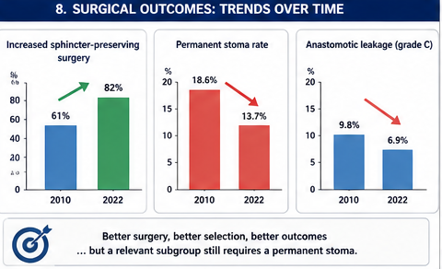

Slide 3
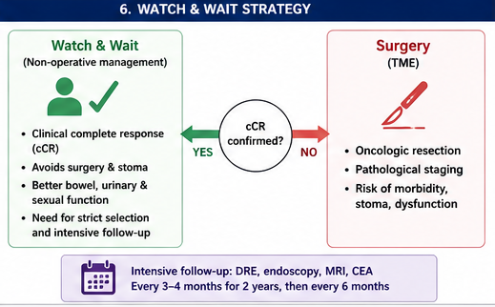

Slide 4
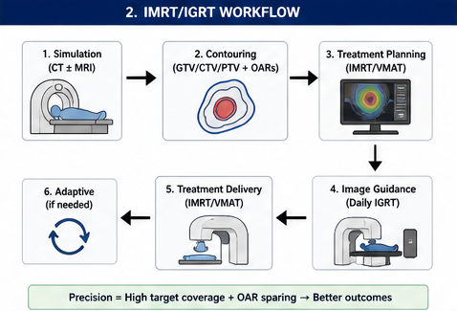

Slide 5
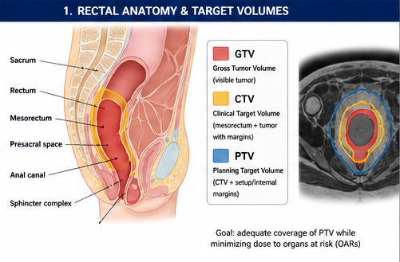

Slide 6
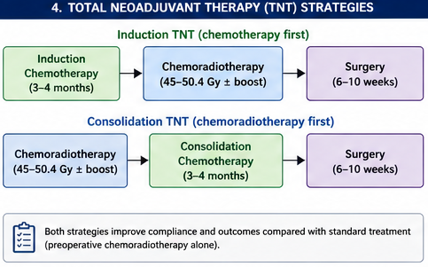

Slide 7
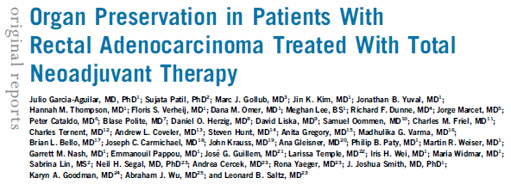
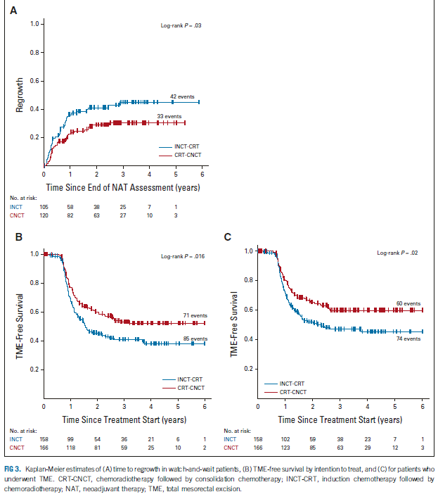

Slide 8
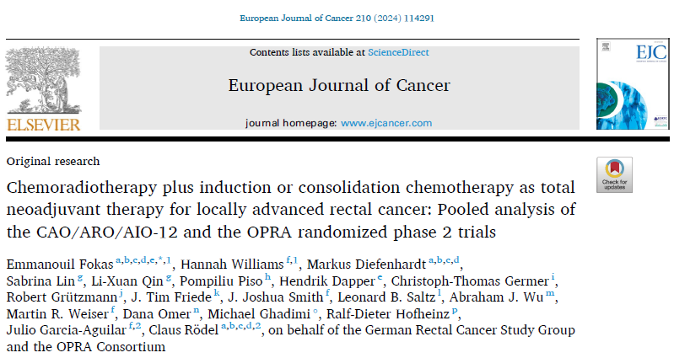
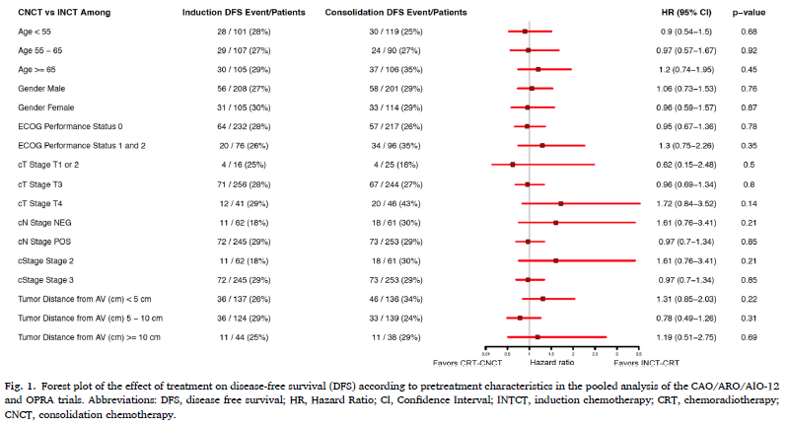

Slide 9
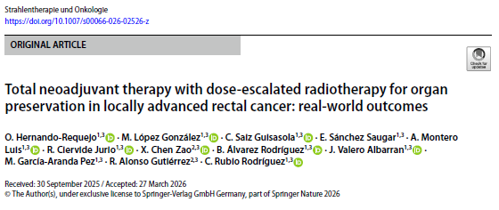
Local control at 3 year = 83.5%
Local control W&W at 3 y = 68.9%
Local control TME at 3 y = 93.5 %
135 patients LARC treated with TNT
RT escalation dose up to 57.5 Gy on GTV
cCR 48.9%
W&W 48.9%
MTB > 42.2% other reason 6.7%
MFS at 3 year = 86%
OS at 3 year = 96%

Slide 10
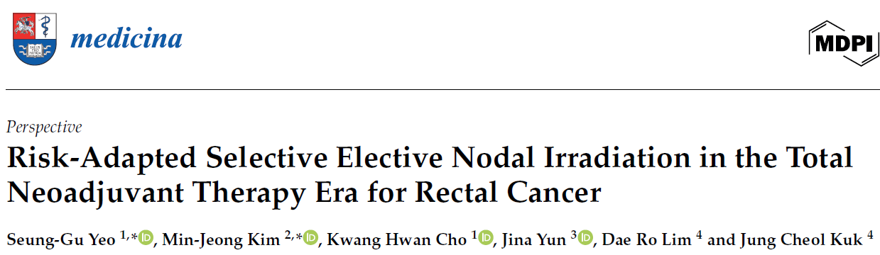
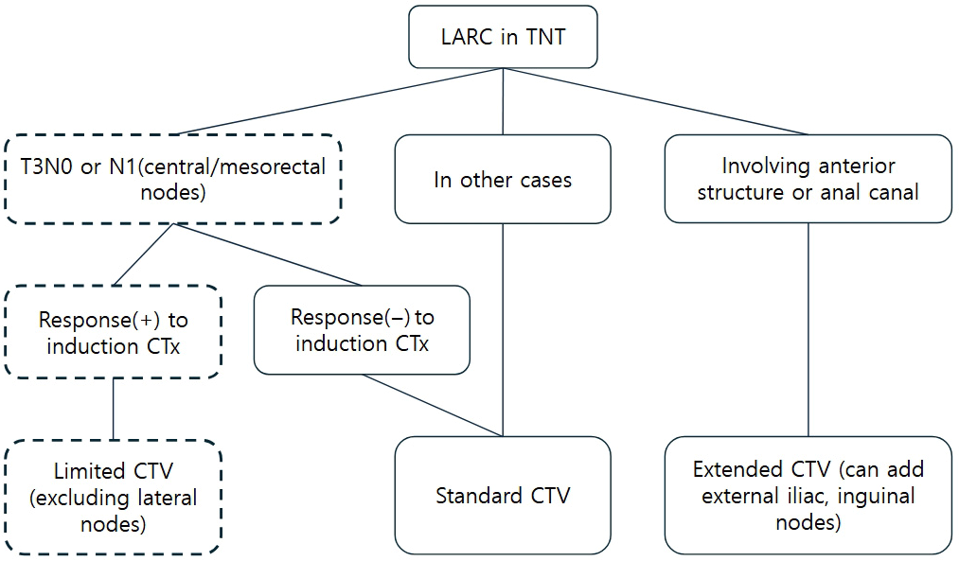
02.04.2026

Slide 11
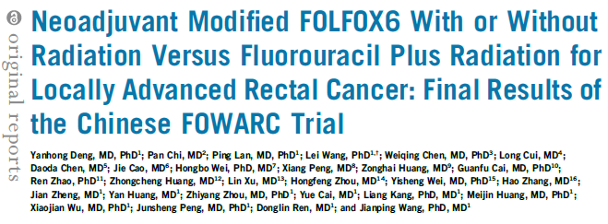
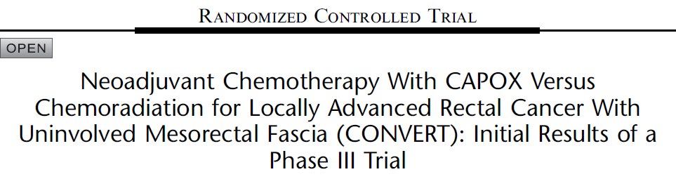
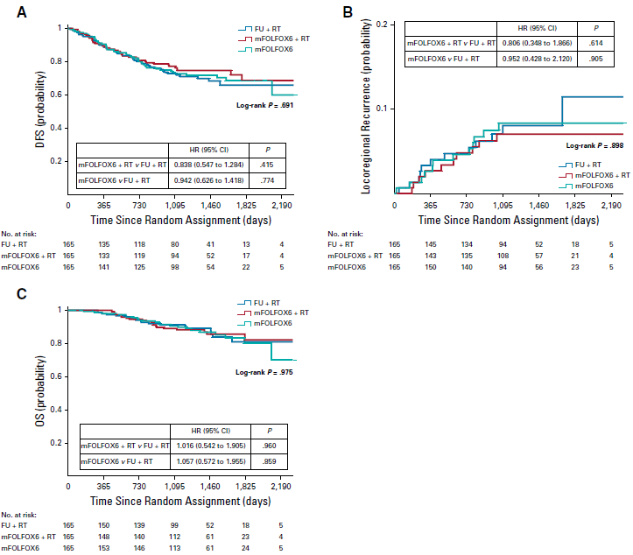
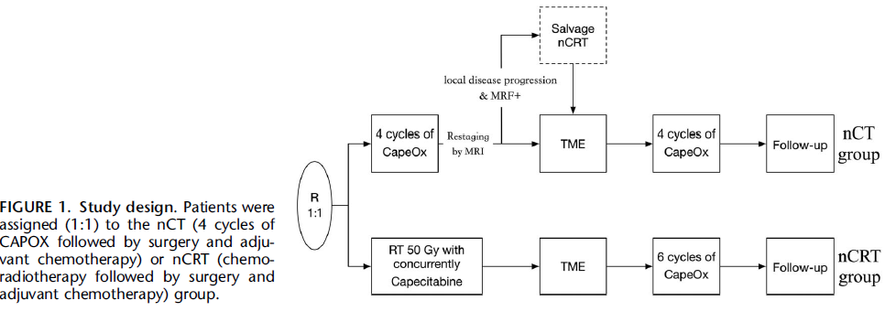
Annals of Surgery Volume 277, Number 4, April 2023

Slide 12
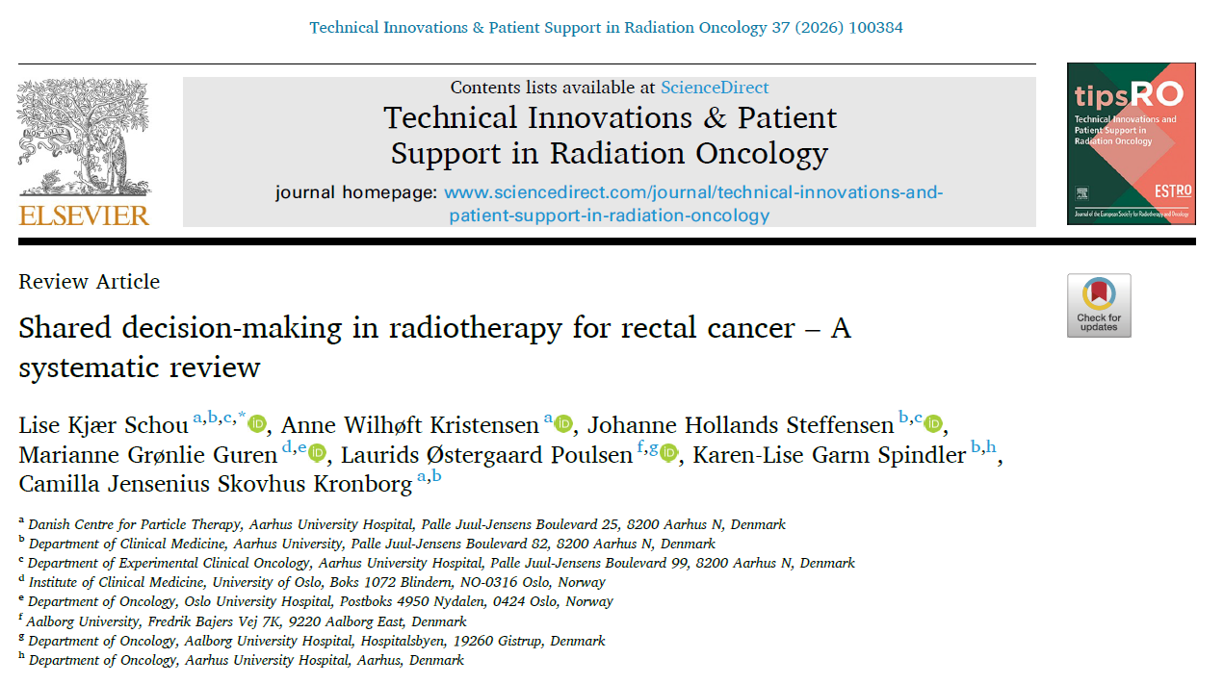
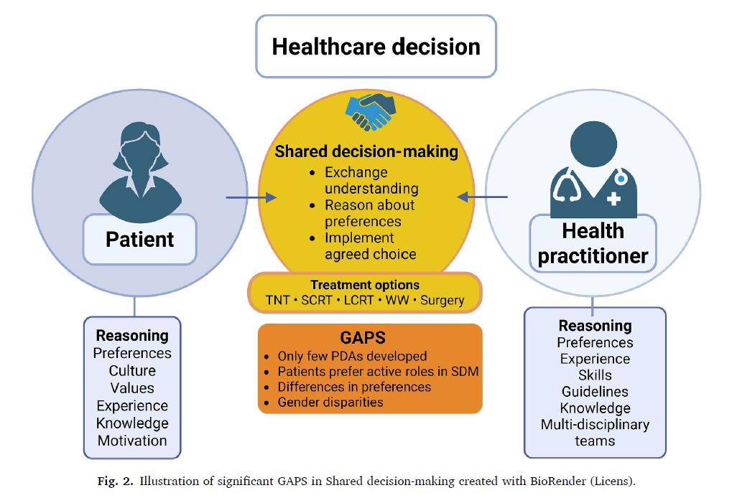

Slide 13
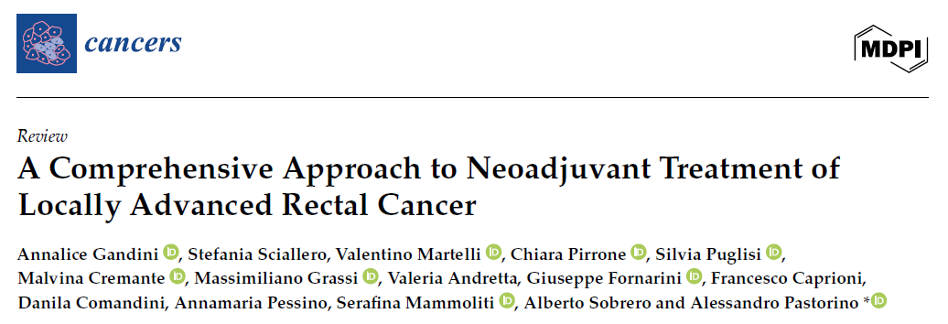
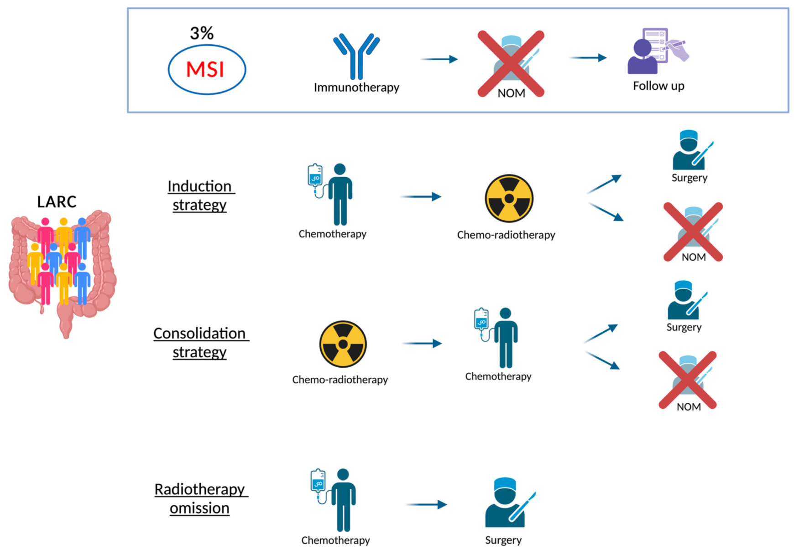
20.01.2025

Slide 14
Conclusion
Shift toward personalized care
Integration and/or modulation of RT, TNT, and surgery
better knowledge and tools for decision support

